Slide 1
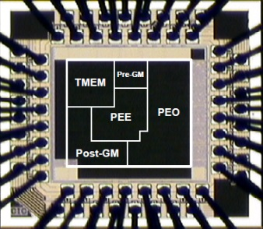
FPGA-IO & Signal Tap
Song-Nien Tang
Department of Information & Computer Engineering
Chung Yuan Christian University
sntang@ice.cycu.edu.tw

Slide 2
Outline
FPGA Design Flow
Synthesis
Implement Design
Synthesis & Fittering
Constraints & pin assignment
IO setting (correct pin assignment)
Post-Simulation (ModelSim-Altera)
Generate bit-stream
Configure Target Device
Signal Tap Probing (It is not simulation!!)

Slide 3
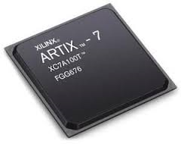
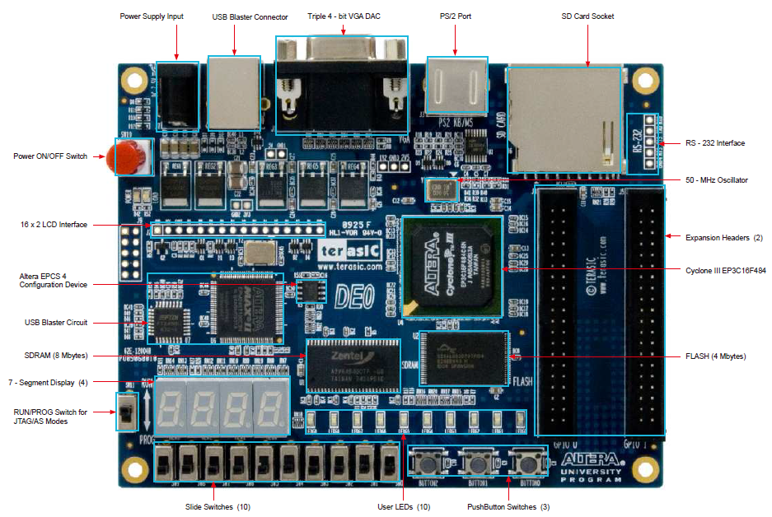
Altera FPGA Evaluation Board

Slide 4
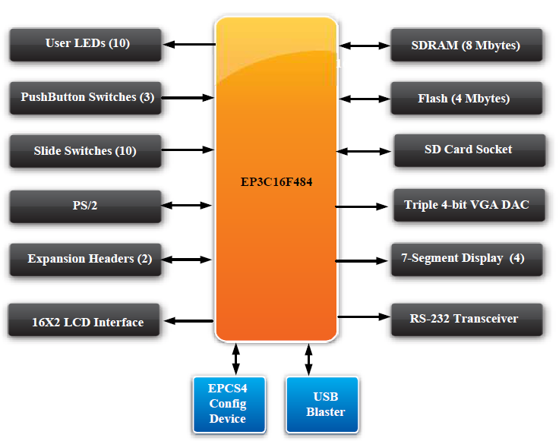
Altera FPGA Evaluation Board

Slide 5
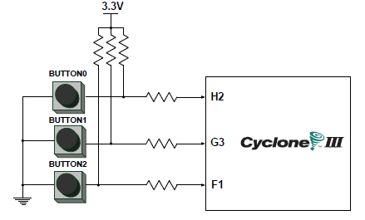
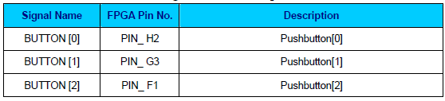
Push buttons

Slide 6
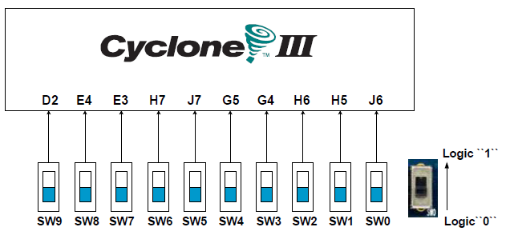
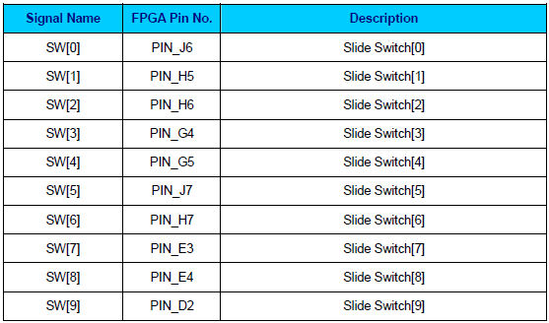
Switches

Slide 7
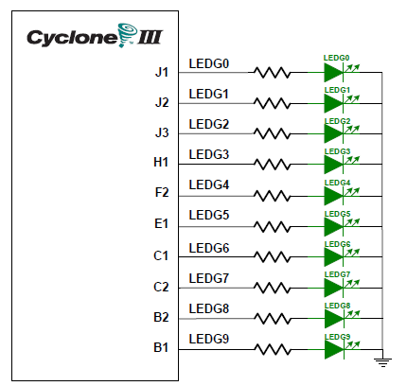
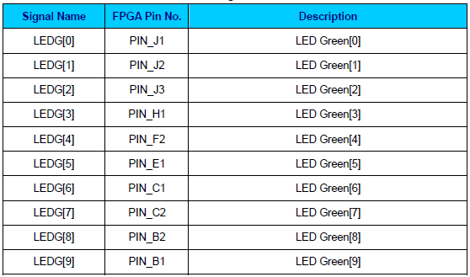
LEDs

Slide 8
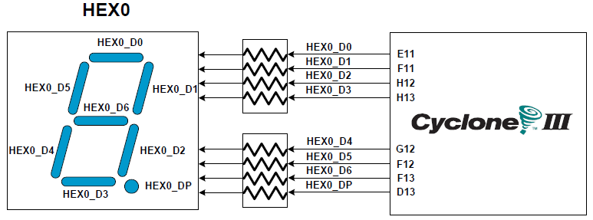
7-Segmment Display

Slide 9
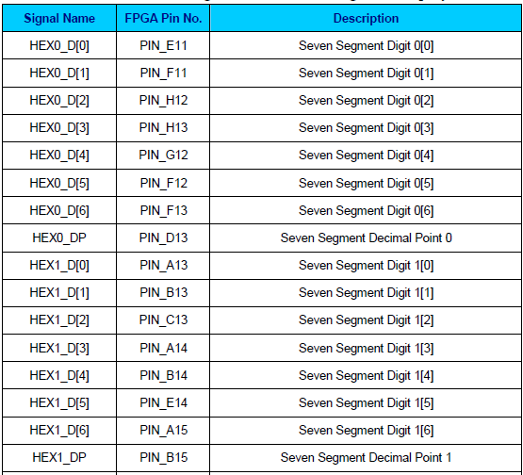
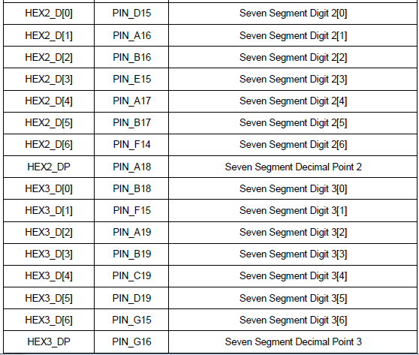
7-Segmment Display [cont’d]

Slide 10
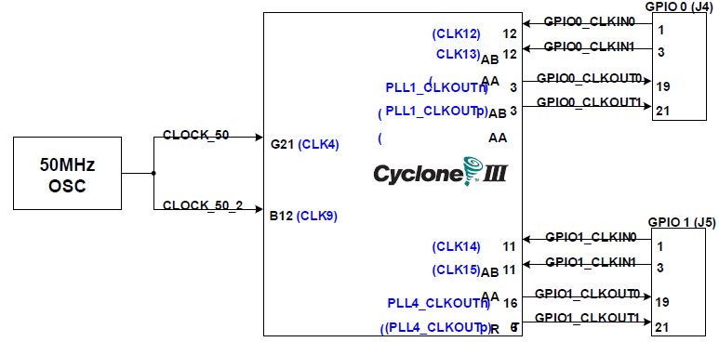
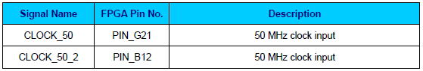
Clock Sources

Slide 11
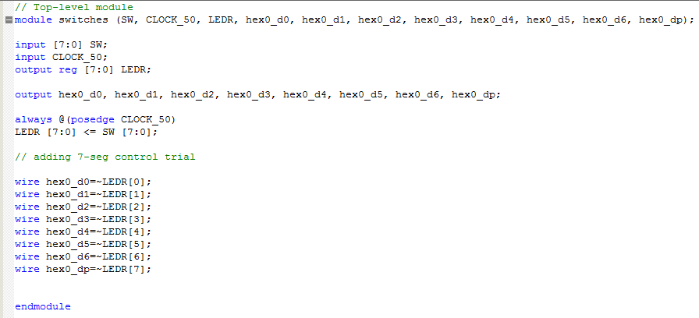
A Sample Code (your Lab.)

Slide 12
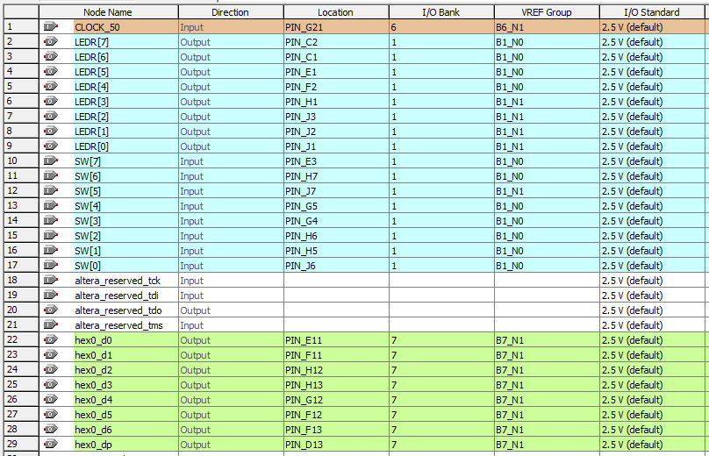
Pin Assignment (the real links)

Slide 13
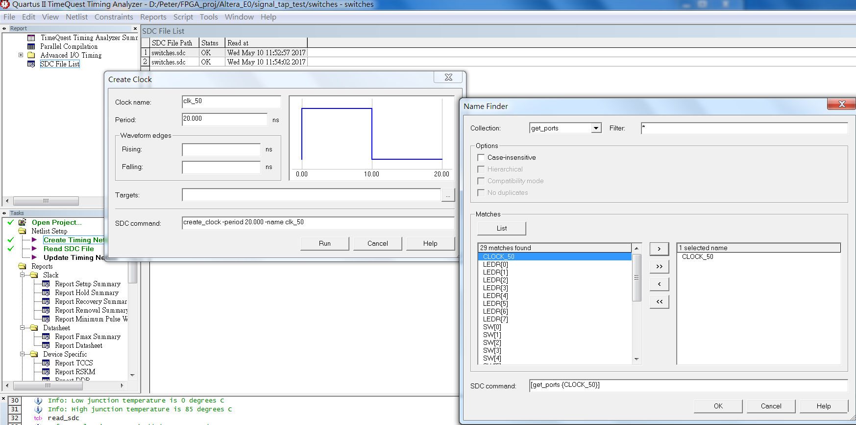
Creat Clock & Write to SDC

Slide 14
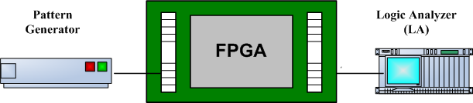
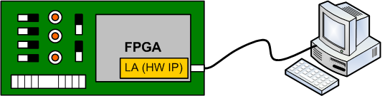
FPGA Measurement (after Implementation)
Before
Now

Slide 15
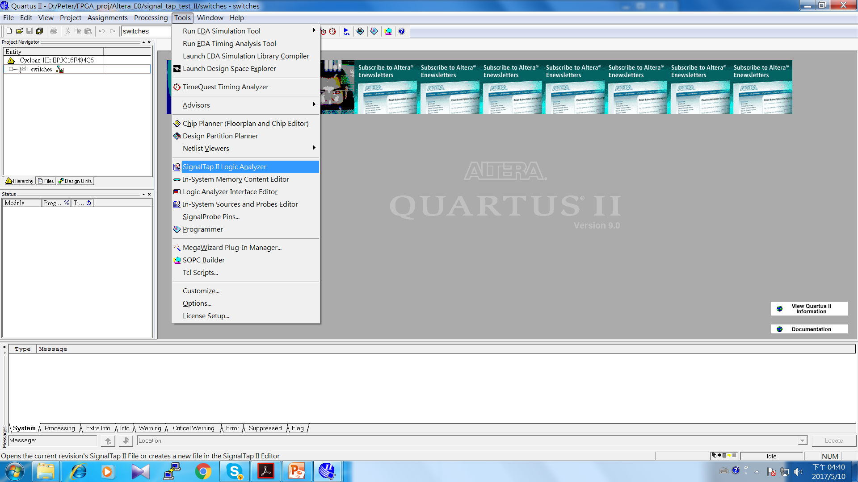
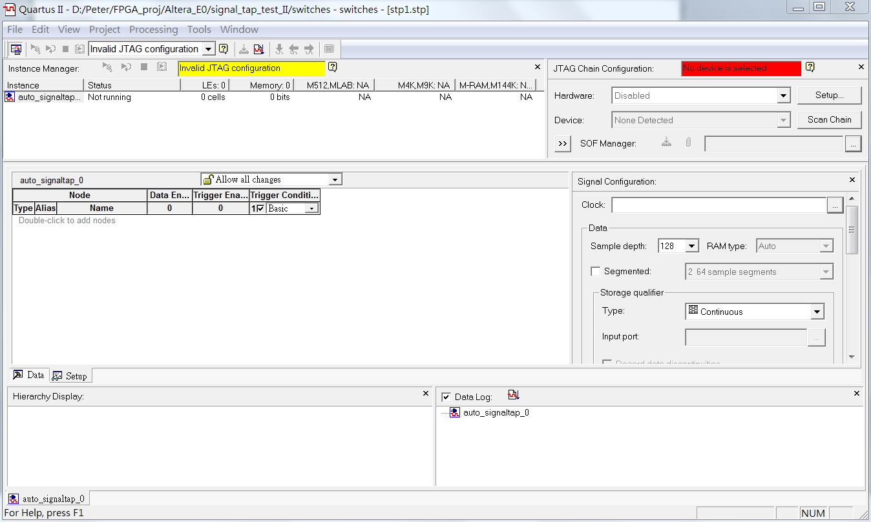
Signal Tap flows (Setting)

Slide 16
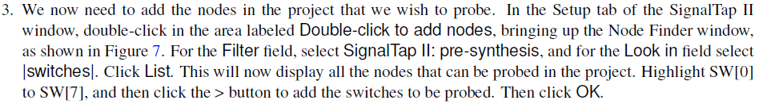
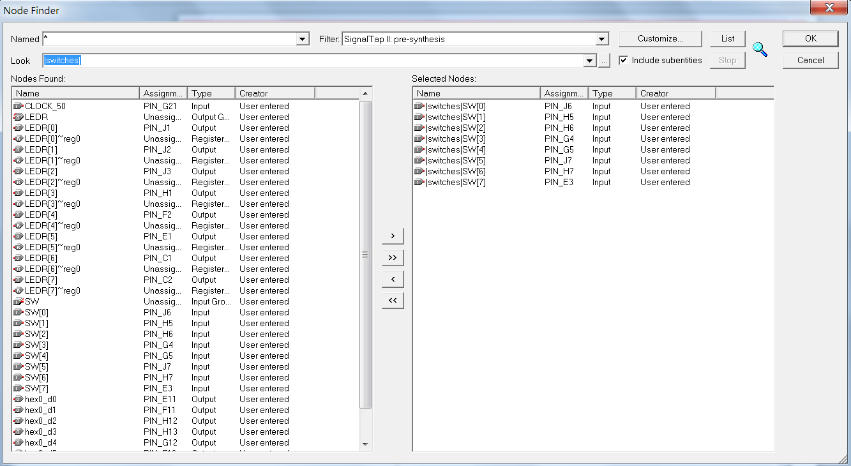

Slide 17
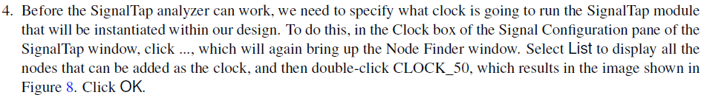
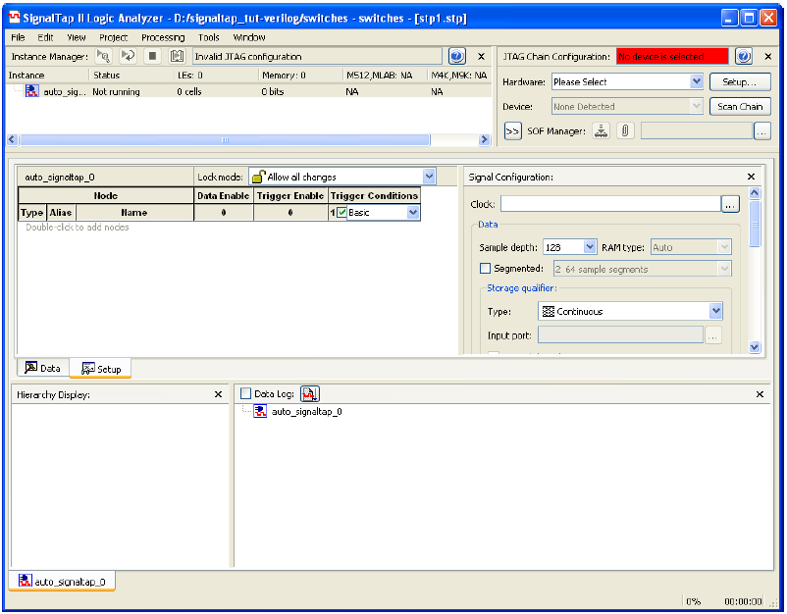

Slide 18
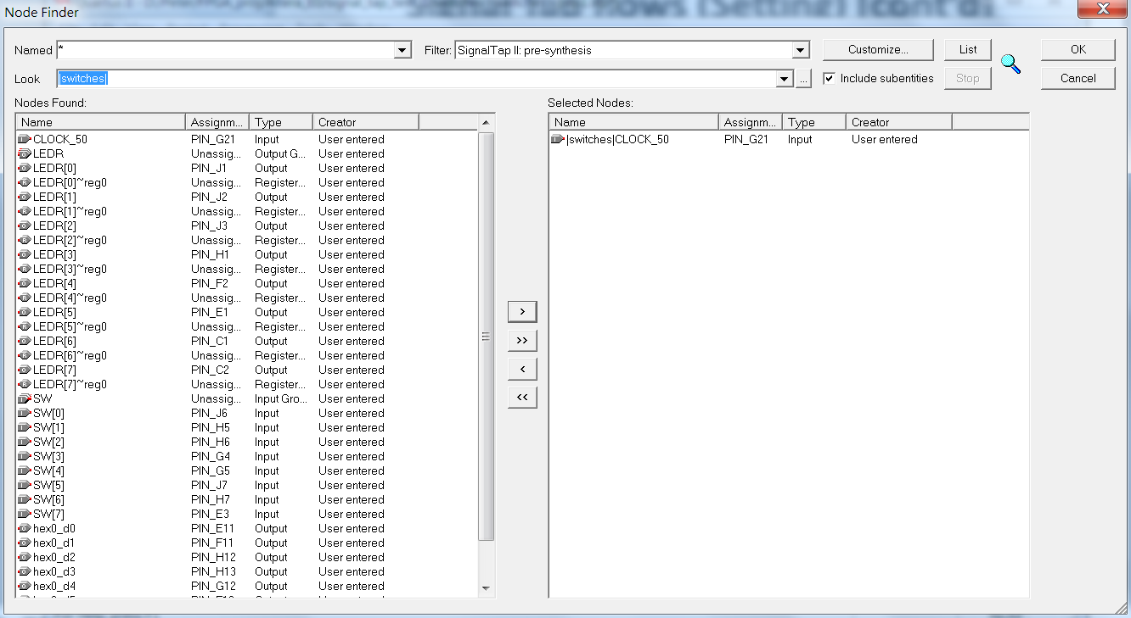
Signal Tap flows (Setting) [cont’d]

Slide 19

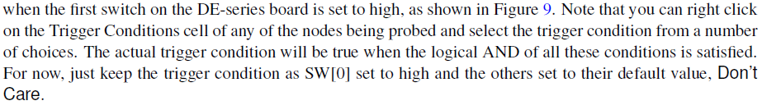
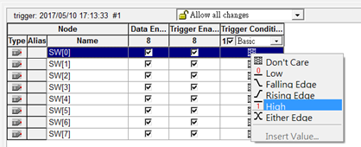
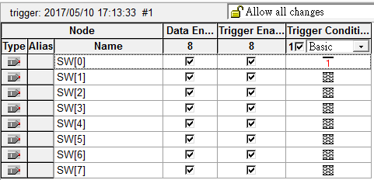
Signal Tap flows (Setting) [cont’d]

Slide 20
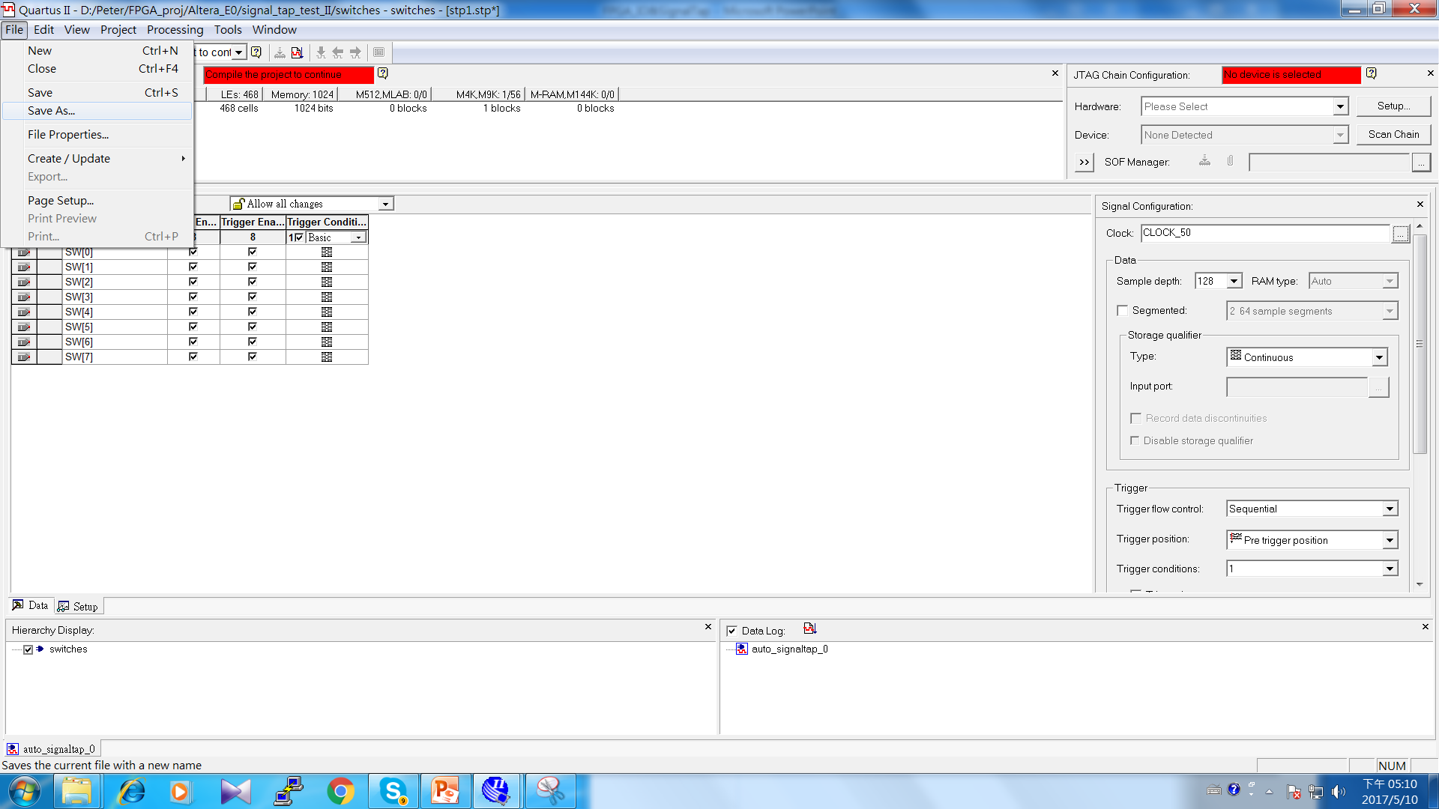
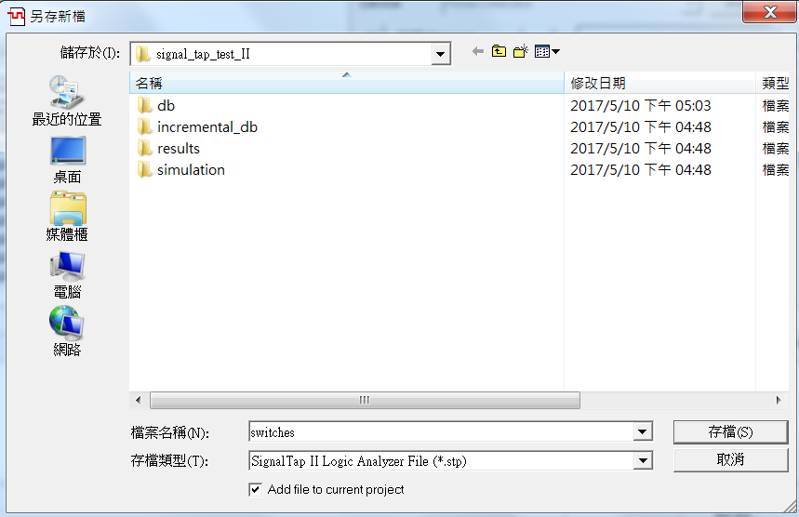
Signal Tap flows (Saving)

Slide 21
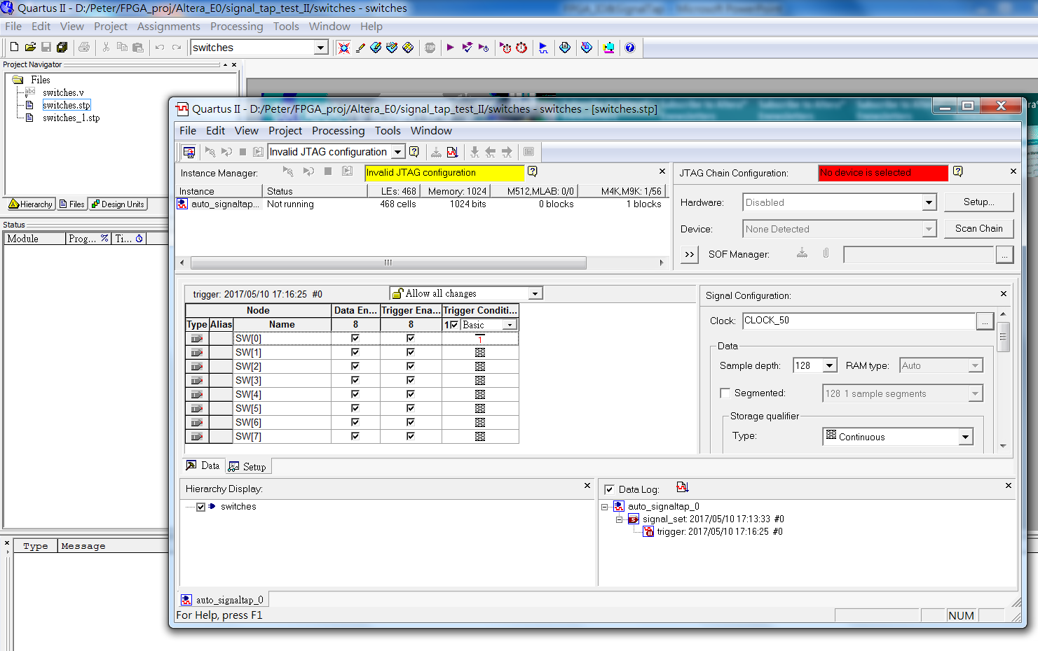
Signal Tap flows (re-loading)

Slide 22
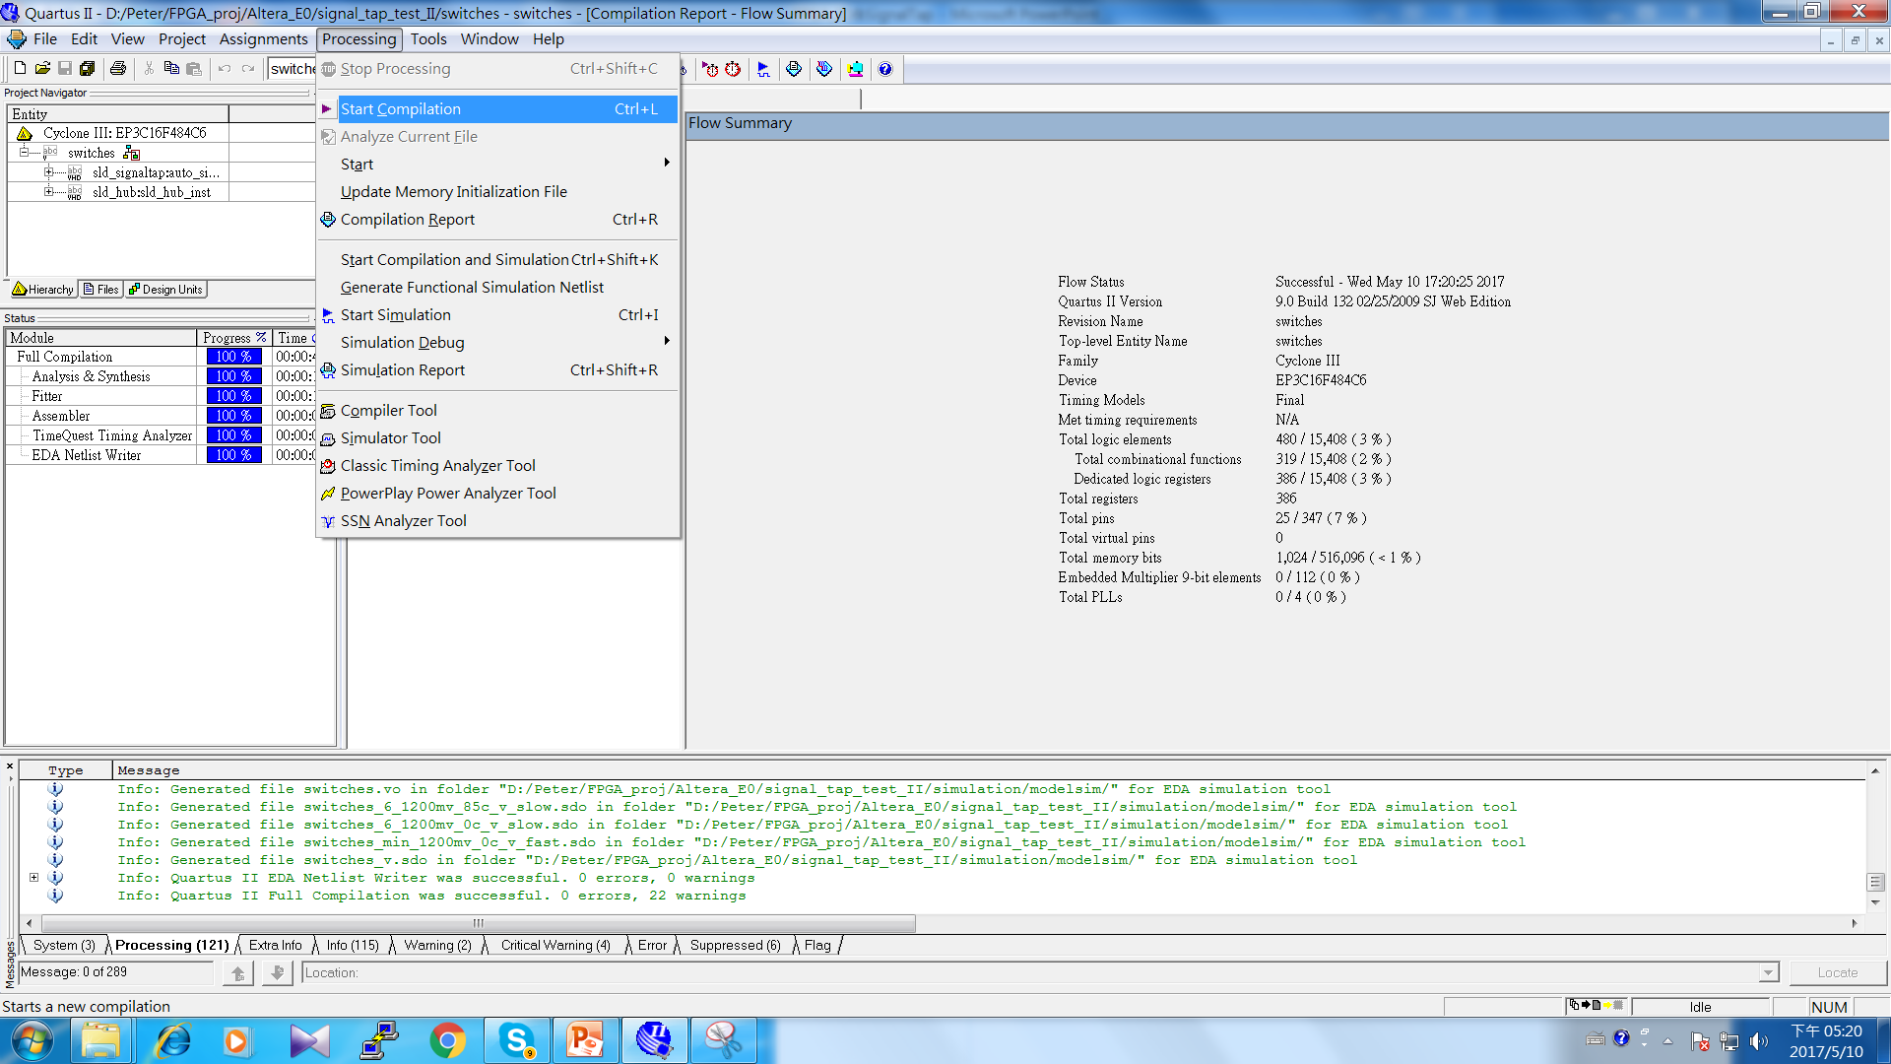
Complication (or Re-Complication)
It is very important !!

Slide 23
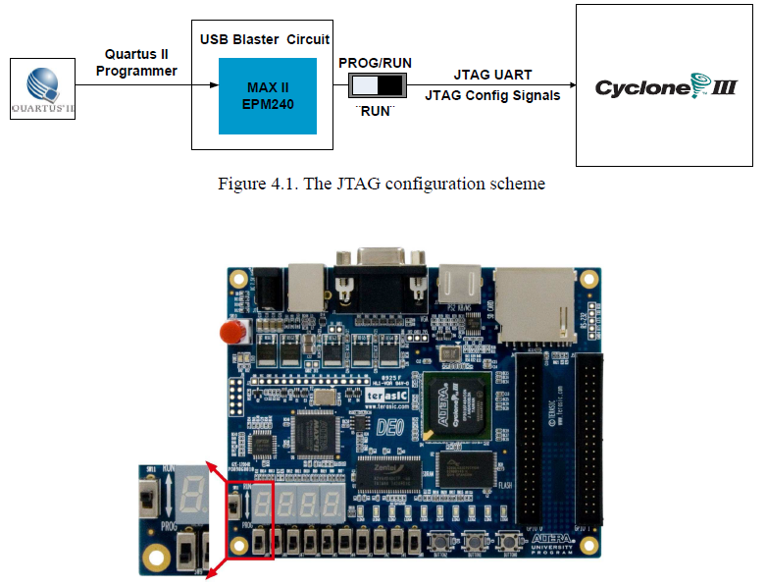
Configuring the FPGA [cont’d]

Slide 24
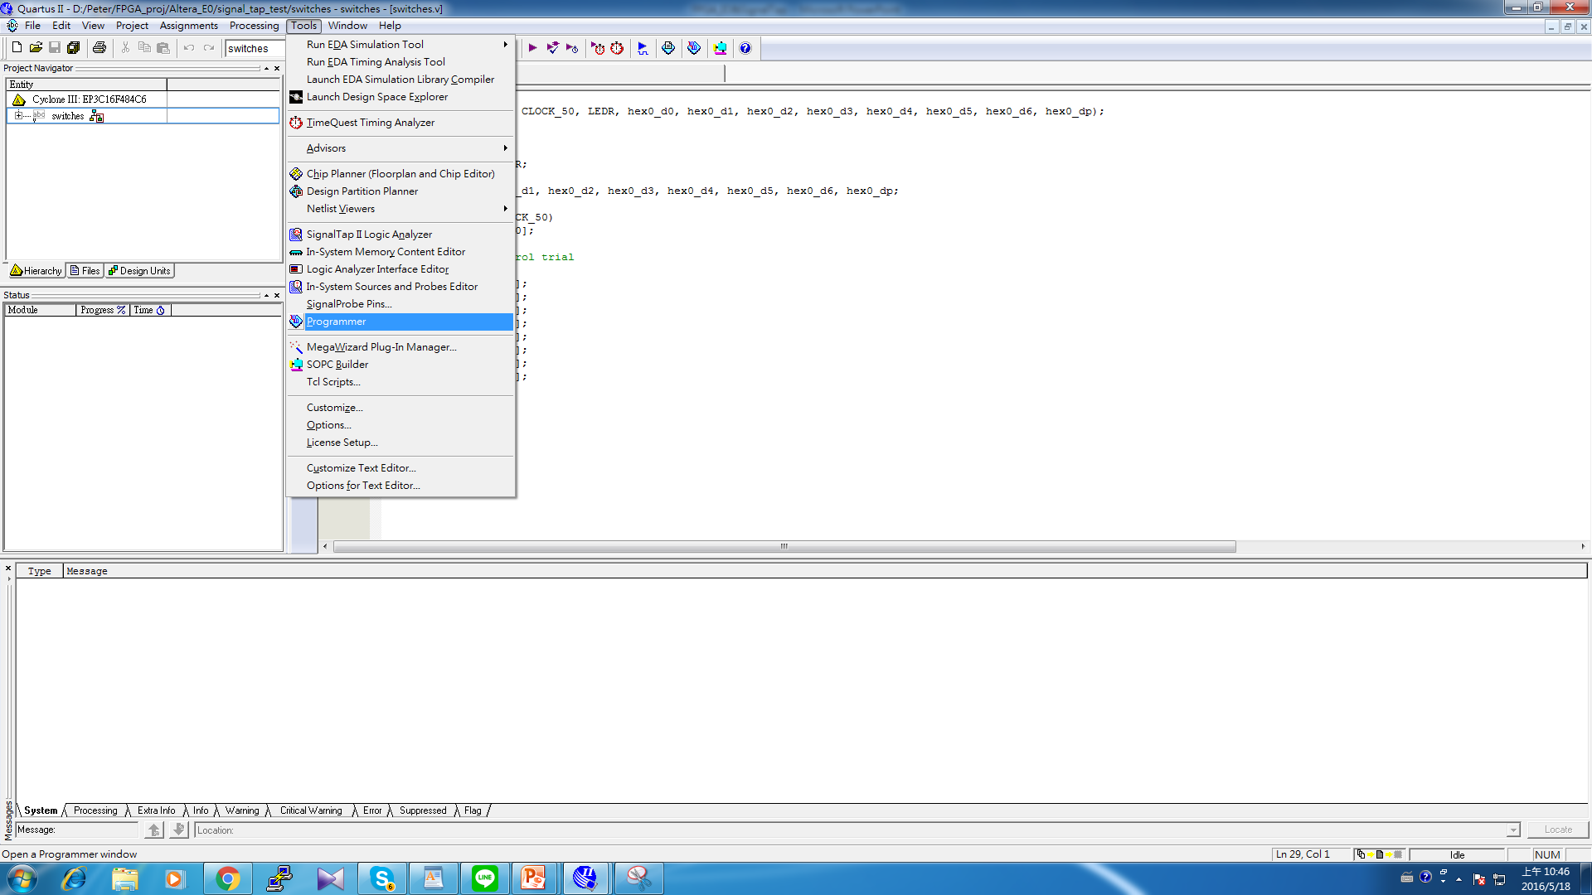
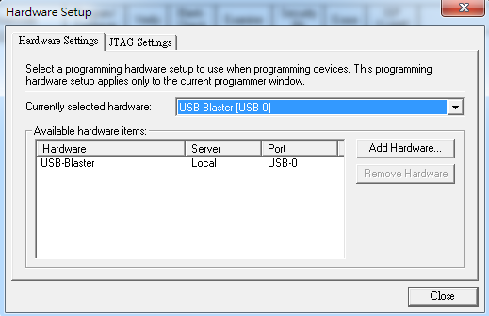
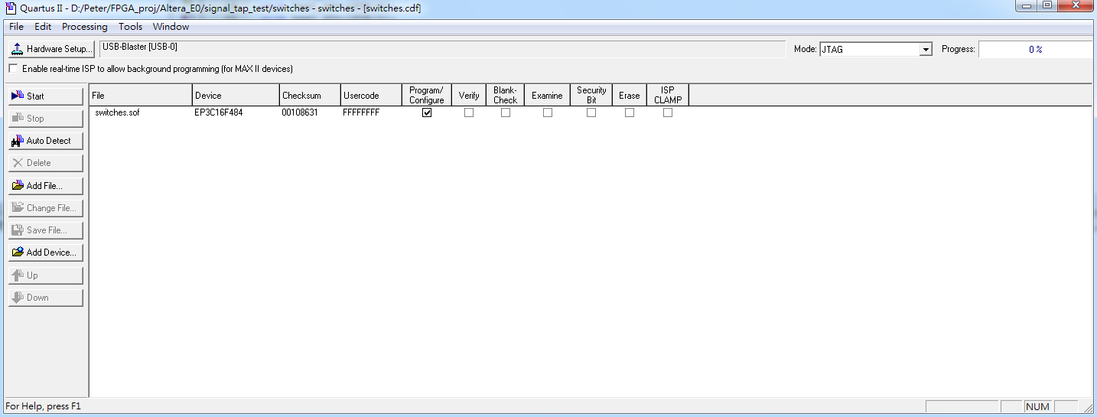
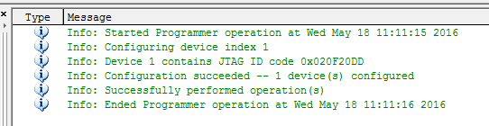
Configuring the FPGA
C:\altera\13.1\quartus\drivers\usb-blaster

Slide 25
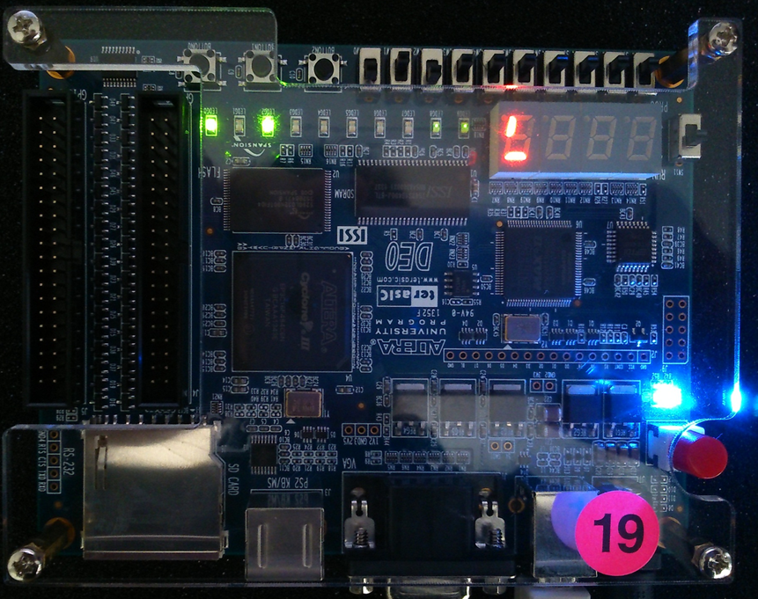
Measurement by I/O Display [1]

Slide 26
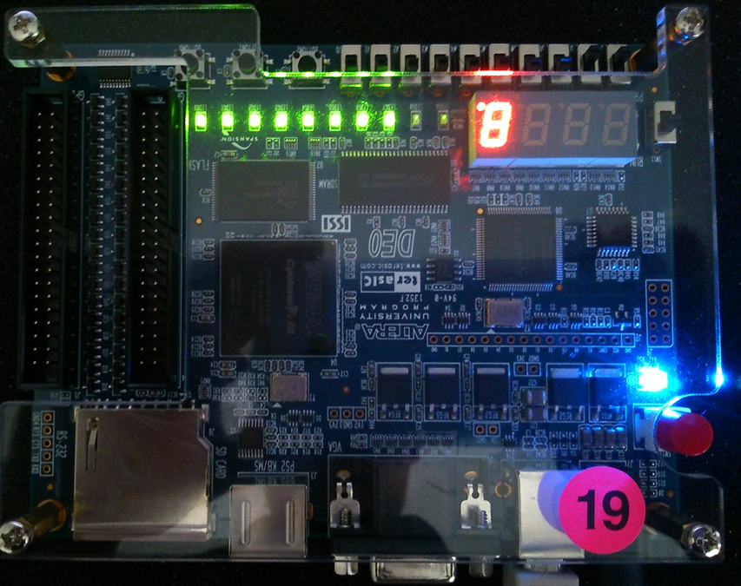
Measurement by I/O Display [2]
(對應的LED燈亮即可，不一定要全亮)

Slide 27
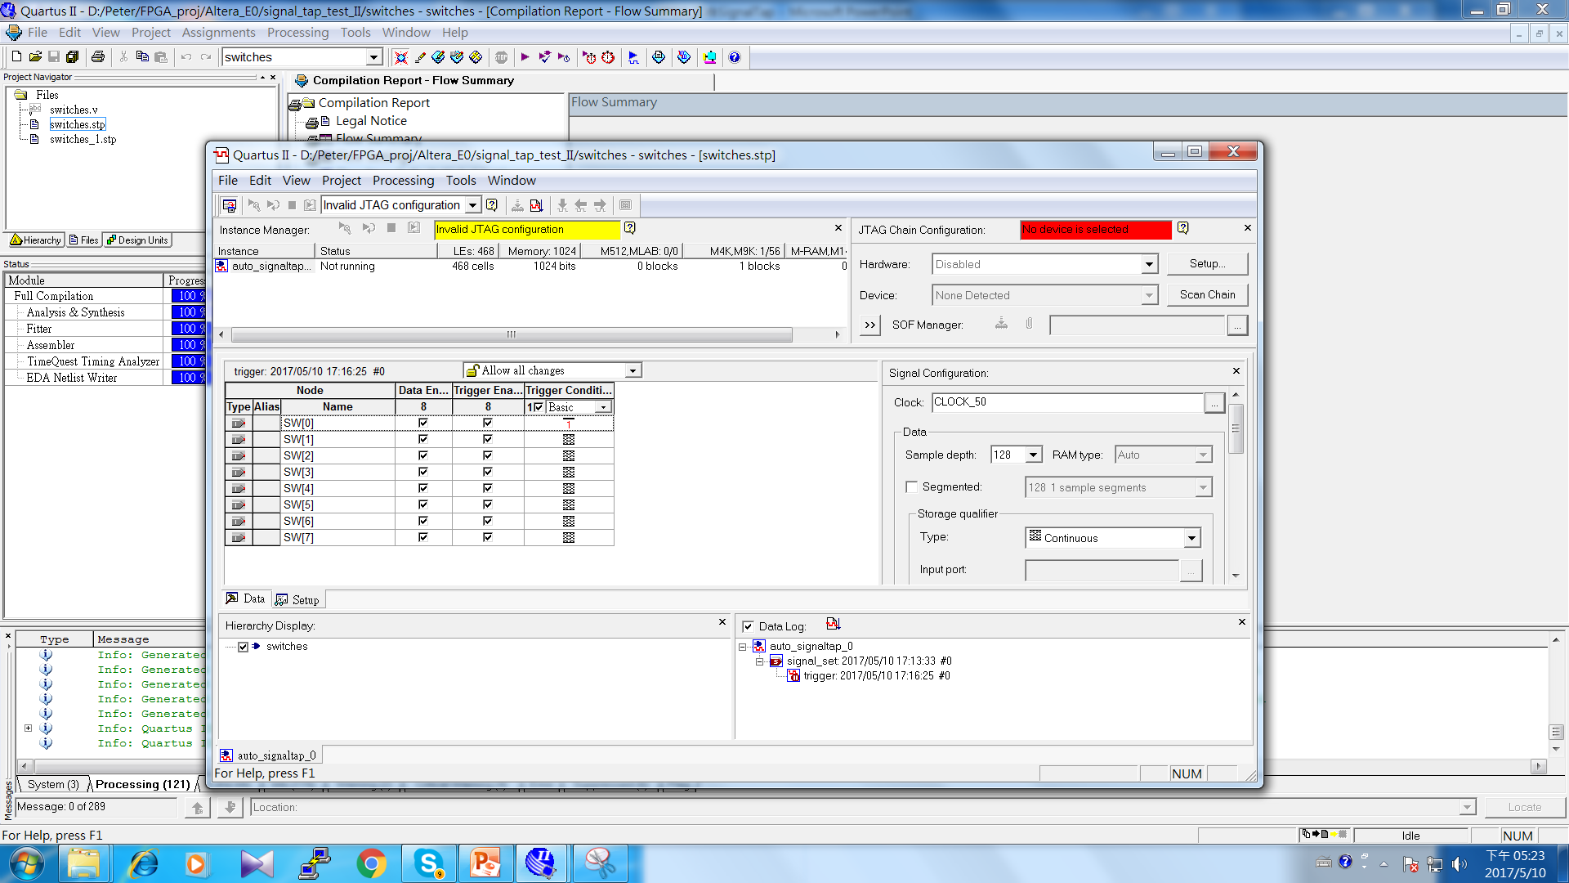
Signal Tap flows (Testing)
注意! 此時SW0~SW7要撥回”0”的位置
(即LED燈都不亮)

Slide 28
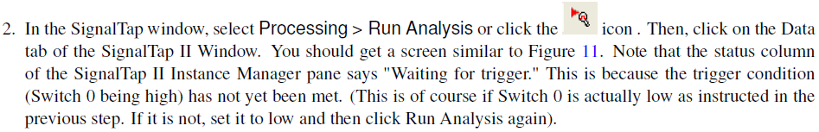
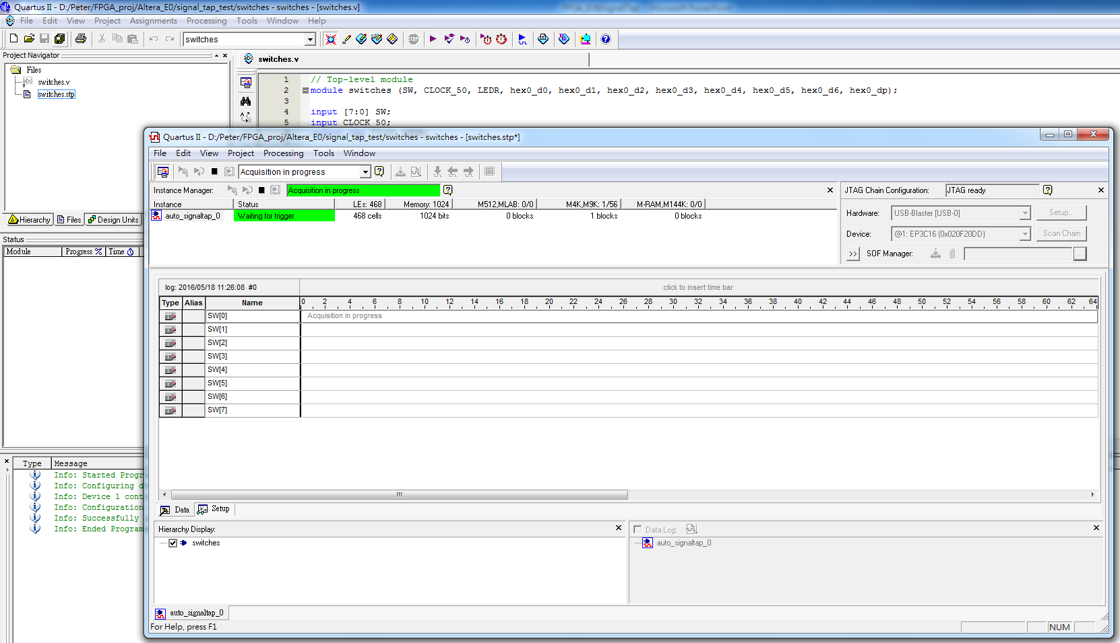
Signal Tap flows (Testing) [cont’d]
注意此部份也要設成USB-Blaster !!

Slide 29
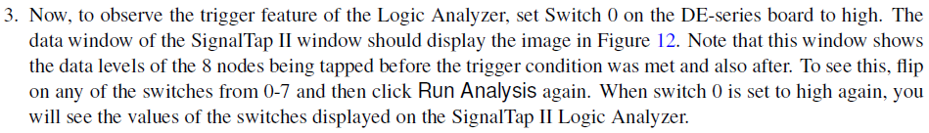
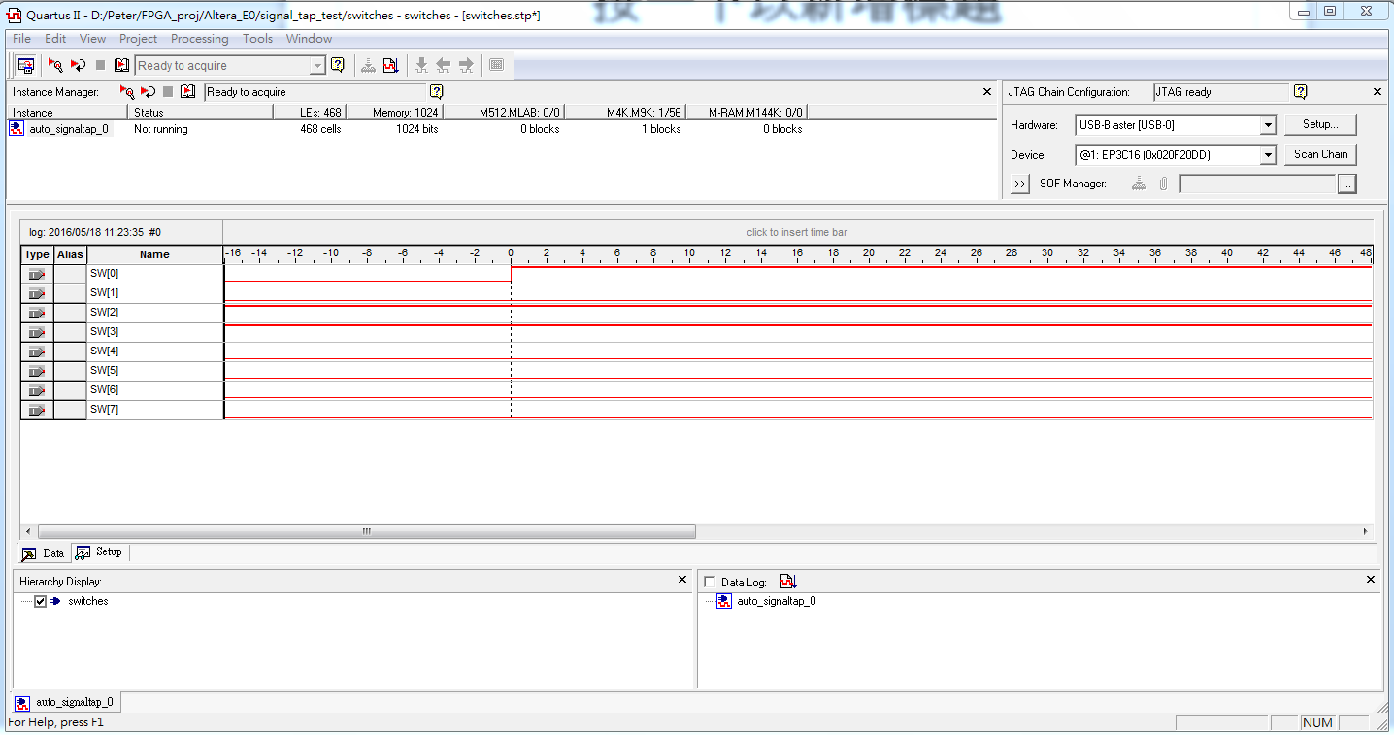

Slide 30
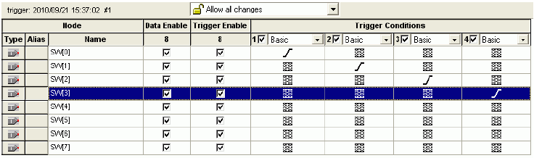
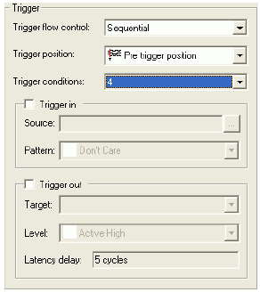
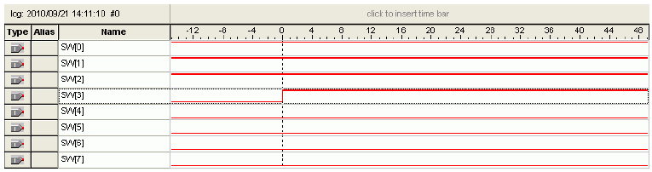
Signal Tap flows (Probing) [cont’d]
僅做練習!

Slide 31
檢查與報告(70%): 5/11、18(四) (兩周緩衝)
1. 撥SW讓LED燈亮的檢查 (p.p.26) (30%)
>> 有做實驗但不成功 (20%)
2. Signal Tap測試的檢查(p.p. 29) (30%)
>> 有做實驗但不成功 (20%)
執行狀況說明或心得 (10%)
>> 此即為報告內容 (5/18 午夜前)
FPGA Design Flow
FPGA Design Flow
Synthesis
Implement Design
Synthesis & Fittering
Constraints & pin assignment
IO setting (correct pin assignment)
Post-Simulation (ModelSim-Altera)
Generate bit-stream
Configure Target Device
Signal Tap Probing (It is not simulation!!)
(5/11) 課程出席 : (30%)
(每位同學做紀錄，分數以個人為單位)

